Slide 1






High Gradient Studies for the Cyclinac, an Accelerator for Hadrontherapy
Silvia Verdú-Andrés
silvia.verdu.andres@cern.ch
PARTNER ESR
TERA (Italy) – IFIC (Spain)
In behalf of the TERA foundation
December 2010 KEK, Tsukuba (Japan)
Notes:
Good morning everybody. Firstly let me introduce myself. My name is Silvia Verdú-Andrés and I am a Spanish PhD student developing my thesis on “New Accelerator Concepts for Hadrontherapy” with the TERA foundation (80%, Italy) and IFIC (20 %, Spain). Today I will speak on behalf of TERA, an Italian foundation based at CERN who is dedicated to research on accelerators and detectors for hadrontherapy. In the last years hadrontherapy has become an important field in Europe and as result, a collaboration between different institutions, financed with European money, has been initiated. TERA belongs to this European collaboration.
It is a pleasure to be at KEK and have the opportunity to speak about the work that TERA is currently doing. I would specially like to acknowledge Higosan for the invitation to give a talk on the “High Gradient Studies for the Cyclinac, an Accelerator for Hadrontherapy”.

Slide 2
Requirements for a Hadrontherapy Accelerator
used for patient treatment!
should provide the best possible treatment to the patient:
- output energy, energy step, time for energy adjustment, repetition rate, intensity, beam quality, …
- machine reliability
in a sustainable facility (reduced operating cost):
- power requirement, maintenance, staff qualification
facilitating initial investment (reduced capital cost):
- machining, power sources, dimensions, …
Notes:
When designing an accelerator for hadrontherapy, one should try to find the best solution

Slide 3
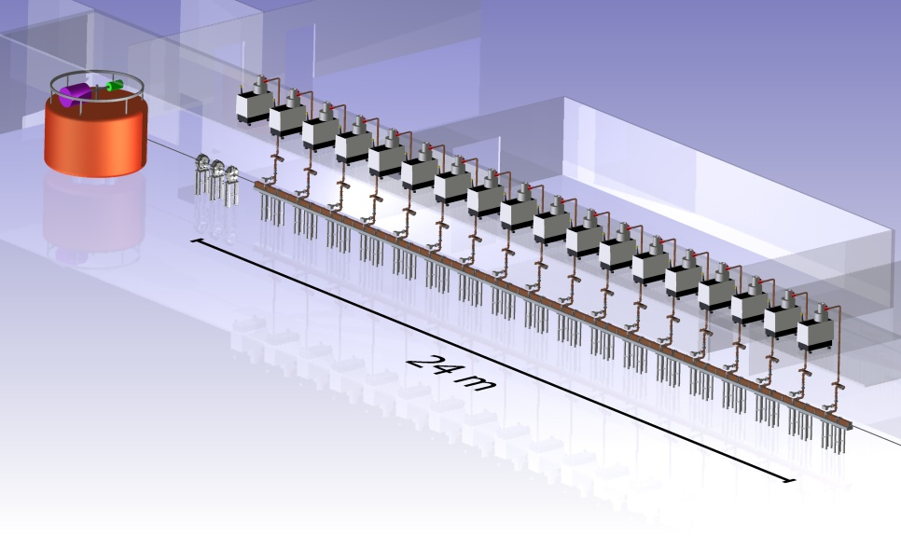
TERA’s proposal: the cyclinac
120
MeV/u
CArbon BOoster for Therapy in Oncology
CABOTO
400
MeV/u
Figura: CABOTO → linac + cyclotron;
Particles, energy range, beam intensity, linac length
Side-Coupled Linac (π/2 mode)
standing-wave structure
CABOTO components
Source | EBIS – SC (C⁺⁶, H₂⁺)
Cyclotron | K 480 - SC 100 tons
Linac | SW SCL 16-18 modules
RF power system | Klystron ~300 Hz (P_{peak} 12 MW)
high-frequency <-> short structure
high-repetiton rate (hundreds of Hz) <-> tumour multipainting
Notes:
Keeping in mind these requirements, TERA proposes the cyclinac. The cyclinac consists of a fast-cycling high-frequency linac which boosts the energy of the particles previously accelerated in a cyclotron.
Typically 16-18 modules
About 40 MV/m operation working point.

Slide 4
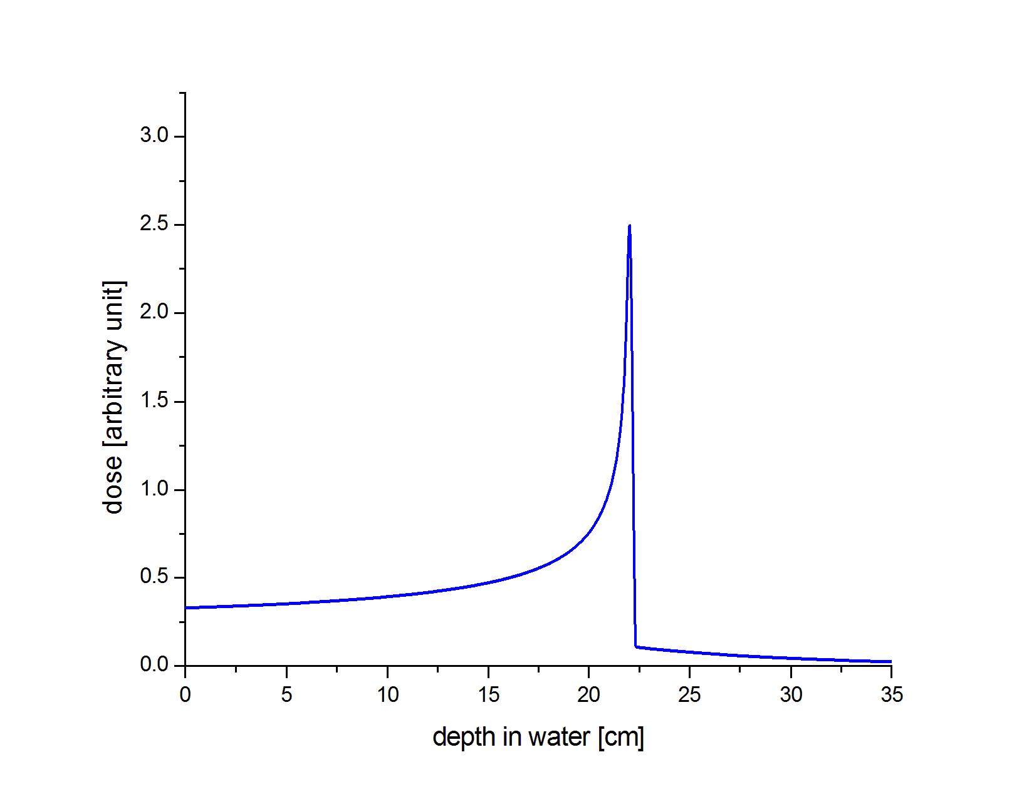
Active energy modulation in the cyclinac
15 mod ON
Notes:
No need of absorbers that diminish/deteriorate beam quality!

Slide 5
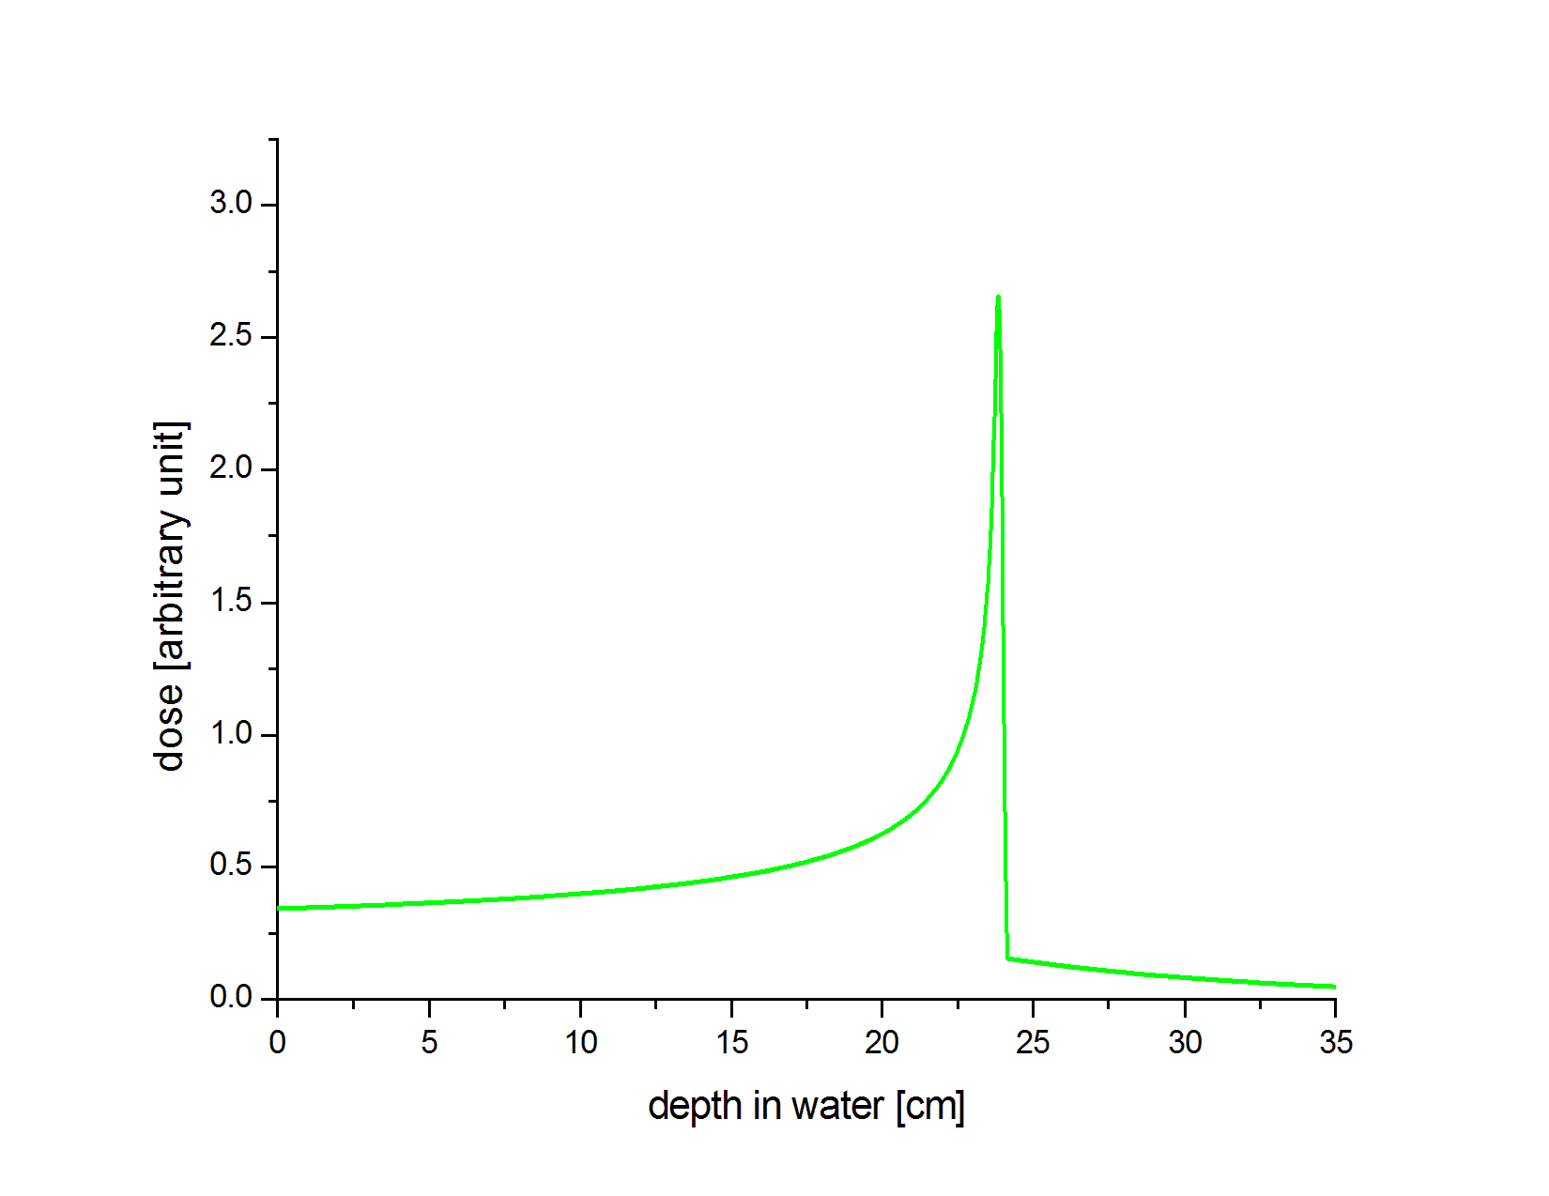
Active energy modulation in the cyclinac
16 mod ON
Notes:
No need of absorbers that diminish/deteriorate beam quality!

Slide 6
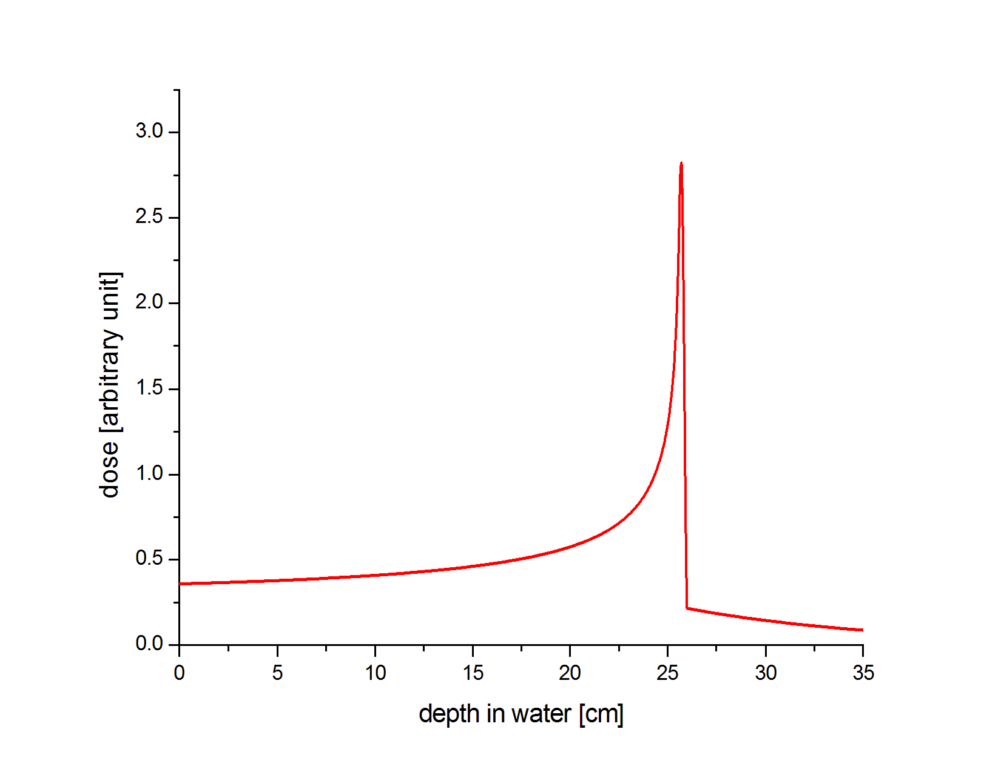
Active energy modulation in the cyclinac
17 mod ON
Notes:
No need of absorbers that diminish/deteriorate beam quality!

Slide 7
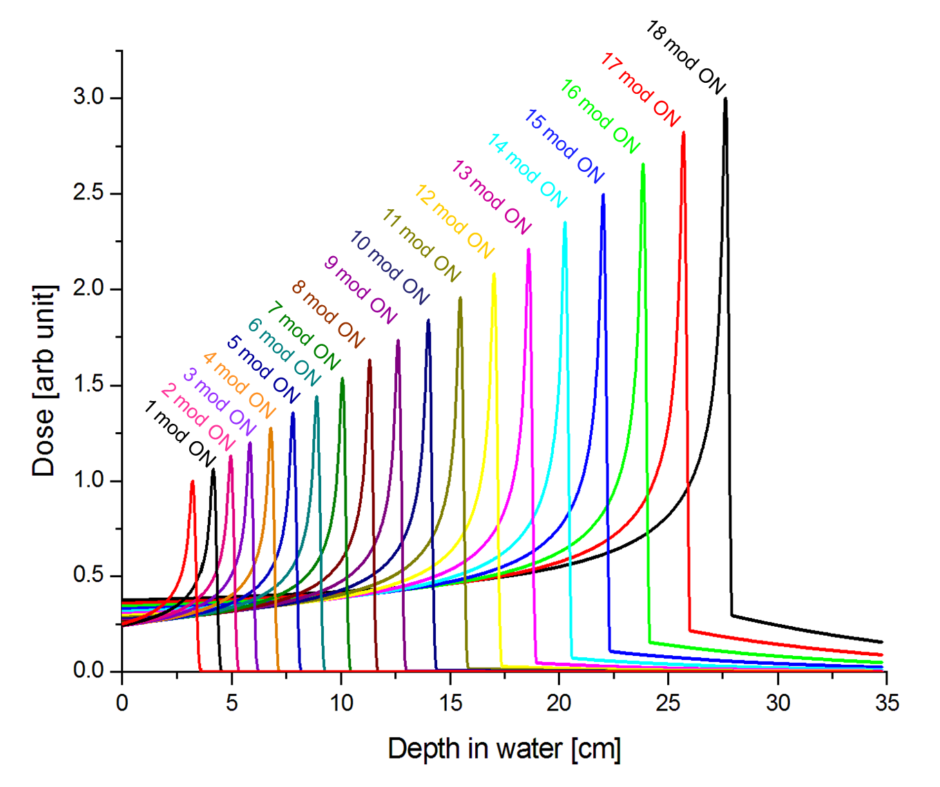
Active energy modulation in the cyclinac
power distribution
fast active beam energy modulation
moving organs
Notes:
No need of absorbers that diminish/deteriorate beam quality!

Slide 8
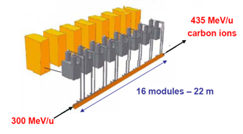
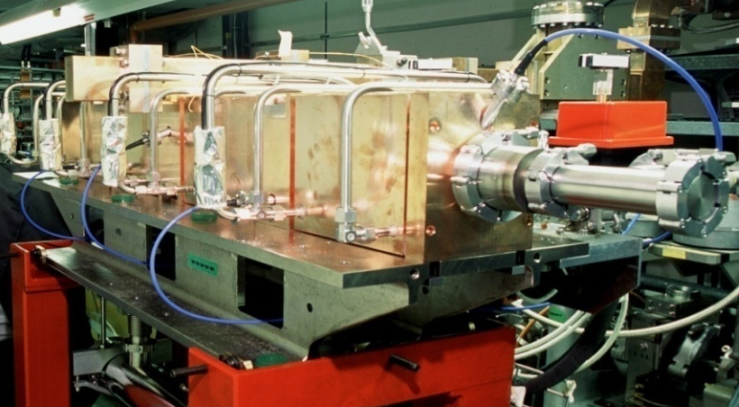
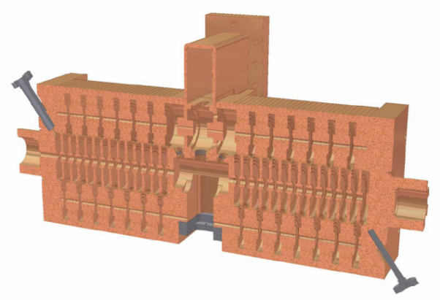
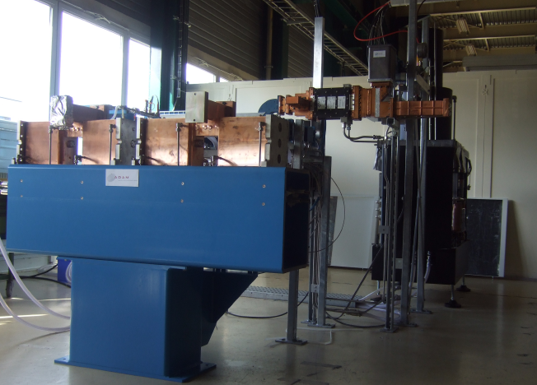
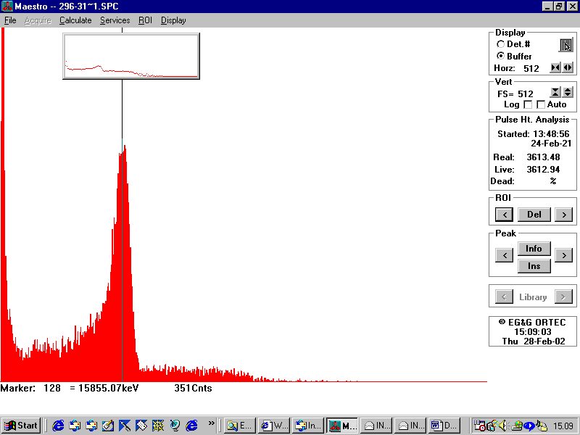
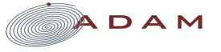
The cyclinac is challenging … but not impossible
1993: first Cyclinac proposal
2001: first IDRA-design
2003: successful acceleration test of LIBO-62 MeV (TERA-CERN-INFN)
2007: first CABOTO design
62 MeV
74 MeV
2009: LIGHT production
Notes:
ADAM is a Swiss enterprise sells the first cyclinac for protontherapy.

Slide 9
A step forward:
reducing power consumption and dimensions
a) inspect linac performance at different frequency bands
[candidates: S-, C- and X-band]
b) go up to high gradients to reduce the linac length
specially needed for the carbon cyclinac
Each proton carries an useless neutron so that a 100 MeV/u acceleration requires 200 MV
For hadron linacs the ratio of the maximum surface field E_{max} to the average accelerating field E_{acc} is E_{max}/E_{acc} ≈ 4-5 → AIM: E_{acc}= 40 MV/m
High frequencies might help in this sense!
Notes:
Specially when we speak about the cyclinac for carbon ion therapy, reduing the power consumption and the dimensions of the machine is really important.
For LIBO and LIGHT, 3 GHz was chosen because it was easy to find RF components in this frequency.

Slide 10


TERA linac designs in S-, C- and X-band
  Why not to increase the frequency?
2007: CABOTO-S 300-430 for SCENT
2009: CABOTO-S 230-400 for Synchrocyclotron
2010: CABOTO-C 150-400 for SC Cyclotron
LINAC Length
Increase in Effective Shunt Impedance
Filling time reduction
RF power source availability
Transverse emittance constraints
Costs of high precision machining
and still the scaling law that relates BDR with frequency has to be found!
Notes:
Linac length comes from compromise between beam dynamics of complex tank distribution for active energy modulation, power sources output and accelerating gradient.
But still the breakdown rate has to be evaluated!

Slide 11

TERA high gradient study program
  Can a 3/5.7 GHz SW cavity be operated reliably with Es= 200-250 MV/m ?
Objectives:
Find maximum achievable field at high frequency
Determine limiting quantities (E, S) and scaling laws (f, t_{pulse})
for optimization of future cyclinacs (reliable operation, reduced dimensions and costs)
3 GHz Single-Cell Cavity
5.7 Single-Cell Cavities
tank (either S- or C-band)
Vodafone foundation Italy has financed the construction of the cavities
Notes:
5.7 GHz Single-Cell cavities → more complete study: diff. Tuning methods, diff. Brazing, diff. Tolerances.
Main question is: Can a 3/5.7 GHz SW cavity be operated reliably with Es= 200-250 MV/m ?

Slide 12
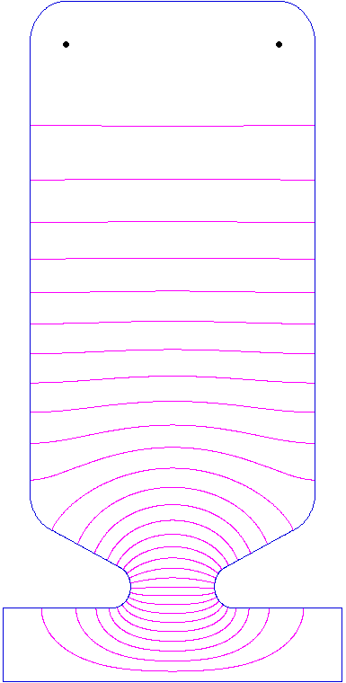
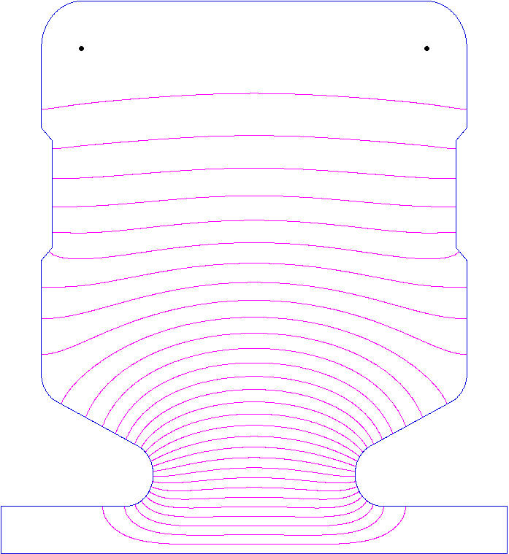
TERA high gradient study program
CAVITY CHARACTERISTICS
S-band
S-band (2.998 GHz) | C-band (5.712 GHz)
 | Tuning ring | Diamond tooling
6.5 | 4.6 | 4.6
2.7 | 2.8 | 2.8
30·10-3 | 25·10-3 | 25·10-3
6 | 30 | 30
20 | 10 | 5
0.4 | 0.4 | 0.025
C-band
E^{max}/E₀ [adim]
H^{max}/E₀ [A/kV]
sqrt(S)/E₀[sqrt(W)/V]
ΔT [degrees]
tol BW [μm]
roughness [μm]
1.5 mm
3.5 mm
Notes:
Linac for Ions → noses → Emax/E0 > 2

Slide 13
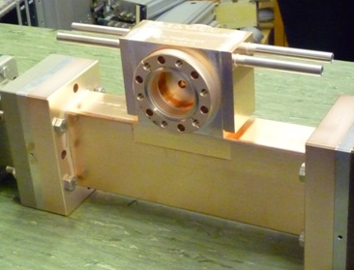
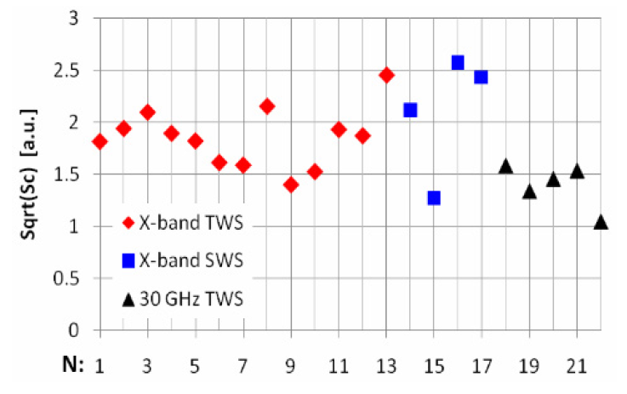
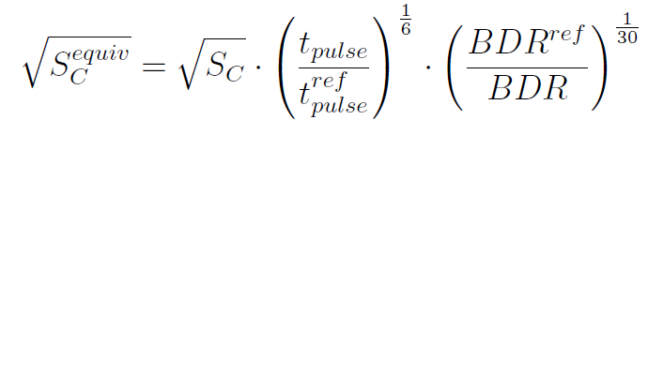
TERA high gradient study program
3 GHz Single-Cell Cavity
Preliminary high-power test performed in Feb 2010 at CTF3
→ max. acc. gradient reached: 55 MV/m (E^{max} = 350 MV/m)
→ preliminary results are consistent with other experiments
The square root of S_{C} scaled to
t_{pulse} =200 ns and BDR=10⁻⁶ bbp/m:
A New Local Field Quantity Describing the High Gradient Limit of Acc. Structures, A. Grudiev, S. Calatroni, and W. Wuensch, Phys.Rev. Accel. Beams (2009) 102001

Slide 14
TERA high gradient study program
3 GHz Single-Cell Cavity
Preliminary high-power test performed in Feb 2010 at CTF3
→ max. acc. gradient reached: 55 MV/m (E^{max} = 350 MV/m)
→ preliminary results are consistent with other experiments
A New Local Field Quantity Describing the High Gradient Limit of Acc. Structures, A. Grudiev, S. Calatroni, and W. Wuensch, Phys.Rev. Accel. Beams (2009) 102001

Slide 15
TERA high gradient study program
3 GHz Single-Cell Cavity
Preliminary high-power test performed in Feb 2010 at CTF3
→ max. acc. gradient reached: 55 MV/m (E^{max} = 350 MV/m)
→ preliminary results are consistent with other experiments
to be high power tested!
A New Local Field Quantity Describing the High Gradient Limit of Acc. Structures, A. Grudiev, S. Calatroni, and W. Wuensch, Phys.Rev. Accel. Beams (2009) 102001

Slide 16
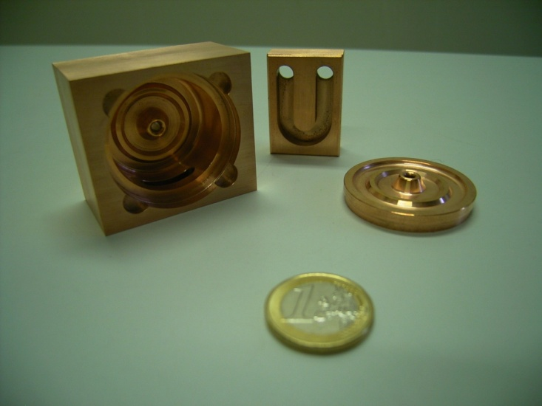
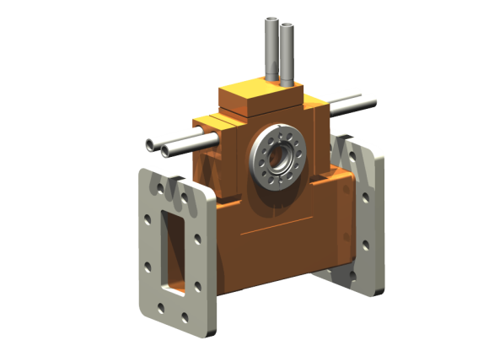
TERA high gradient study program
5.7 GHz Single-Cell Cavity with tuning ring
Waiting for low power measurement and tuning
5.7 GHz Single-Cell Cavity without tuning ring
under construction…
to be high power tested!
Notes:
And these cavities should be high-power tested!!!!!!!! (where?)
2 MW needed for testing
From my experience in the last days, I have noticed that KEK is a nice place to perform high gradient studies. Next year TERA will have a couple of C-band single-cell cavities for high-power testing.
From experimental results we will chose between S- or C-band and we will build a tank which should also be high-power tested.

Slide 17
Summary
Cyclinac is a good machine for hadrontherapy…
  High Repetition Rate : 300 Hz → tumor multipainting
  Total power consumption ~ 800 kW → reduced costs
  Fast active energy modulation → moving organs
  High Accelerating Gradients → reduced size
A lot to do…
  Comparison between linac designs in S-, C- and X-band
  High Gradient Study Program:
    Some single-cell cavities (S- and C- band) to be high-power tested
    An incoming high-frequency tank to be built and tested

Slide 18
Bibliography
I prepared a folder with docs: ask Higosan

Slide 19
Thanks for your attention
This work received funding from the Seventh Framework Programme [FP7/2007-2013] (grant agreement n215840-2).

Slide 20
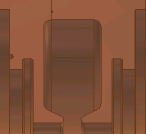
Back-up slides
max. E
Maximum field values appear in the nose region
max. H
max. S_{c}

Slide 21
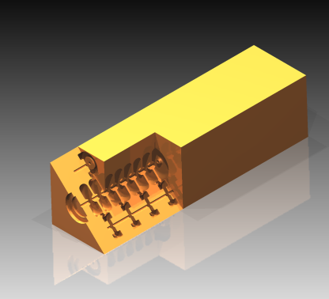
TERA’s proposal: the cyclinac
high-frequency <-> short structure
high-repetiton rate (hundreds of Hz) <-> tumour multipainting
120
MeV/u
CABOTO
120-400 MeV/u
400
MeV/u
Figura: CABOTO → linac + cyclotron;
Particles, energy range, beam intensity, linac length
Side-Coupled Linac (π/2 mode)
standing-wave structure
CABOTO components
Source | EBIS - SC
Cyclotron | K 480 - SC 100 tons
Linac | CCL @ 5.7 GHz 16 modules
RF power system | Klystron (P_{peak} 12 MW)
CABOTO =
CArbon BOoster for Therapy in Oncology
accelerating cell
BEAM
coupling cell
Notes:
Keeping in mind these requirements, TERA proposes the cyclinac. The cyclinac consists of a fast-cycling high-frequency linac which boosts the energy of the particles previously accelerated in a cyclotron.

